Slide 1

College Automation and Scheduling System
Sparsh Wabhale - 20BCE1651

Slide 2

Abstract
College Automation System is a multi-function processing operation which includes several modules that are working as one unit in general. It is a software that can keep a systematic record of student’s details, mark sheet, attendance and defaulters list. This project enables the easy way of maintaining class attendance with fewer efforts. It has better product perspective, functionalities, Design and implementational uses than the traditional method of manual work as it holds many advantages over it like minimizes Processing time, eliminates human errors and records can be easily searched and reports can be easily generated.
This project uses a web application concept to facilitate the departmental system in educational institutes. It uses the most reliable way of uniquely identifying students through website. Such type of web application is very useful in college for daily attendance. Hence, this project introduces a manageable and systematic approach of maintaining student and staff records.

Slide 3
Features
1. It provides a single source of data repository for streamlining your business processes and reporting purposes.
2. It has a simple user interface and is intuitive. This ensures that the users spend less time in learning the system and hence, increase their productivity.
3. Efficient security features provide data privacy and maintains data integrity.
4. Enables easy modifications, easy collaboration over the internet and offers complete lifecycle management for your business processes.
5. Supports your institution’s daily operations by eliminating duplicate data entry, sharing the most up-to-date information, maintaining a detailed history of essential records

Slide 4
System Architecture

Slide 5
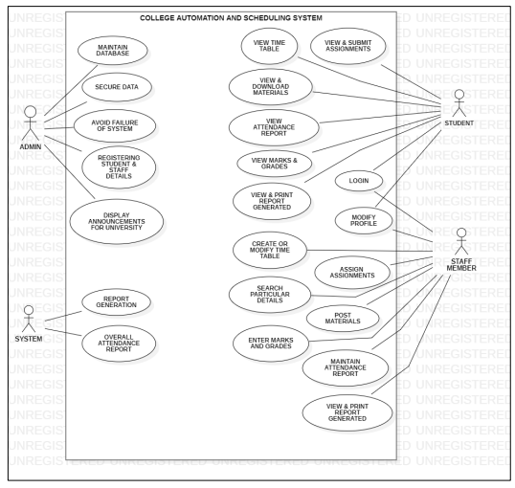
USE CASE DAIGRAM (UML)

Slide 6
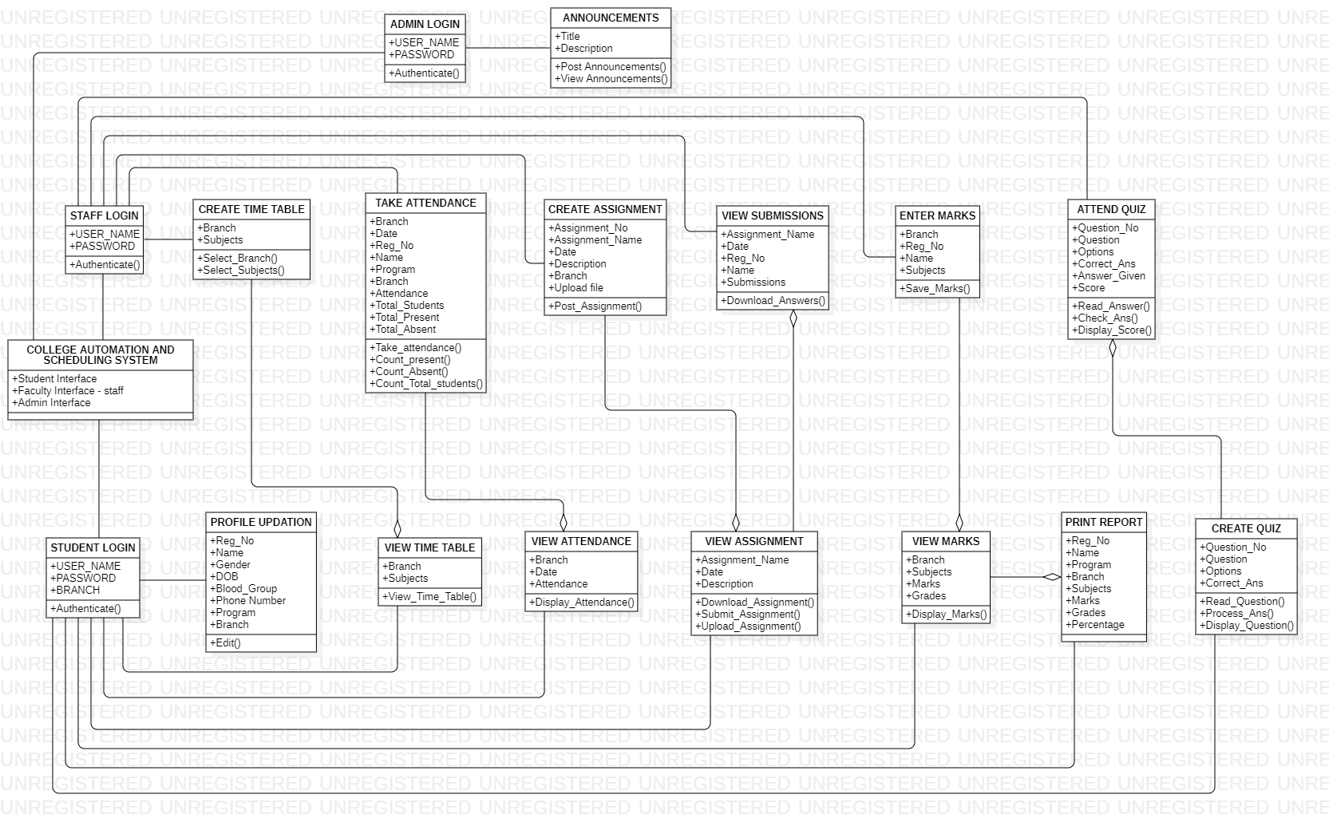
CLASS DIAGRAM

Slide 7
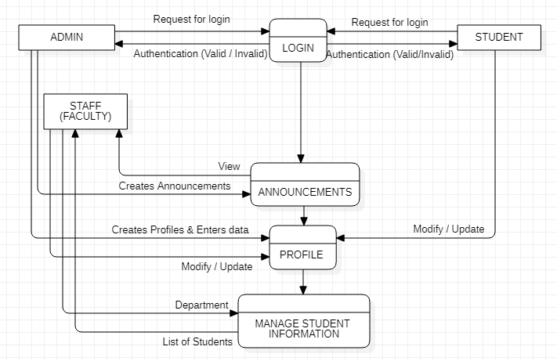
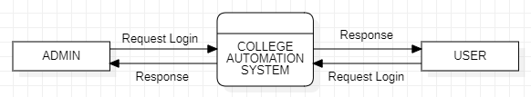
DFD DIAGRAM
LEVEL - 1
LEVEL - 0

Slide 8
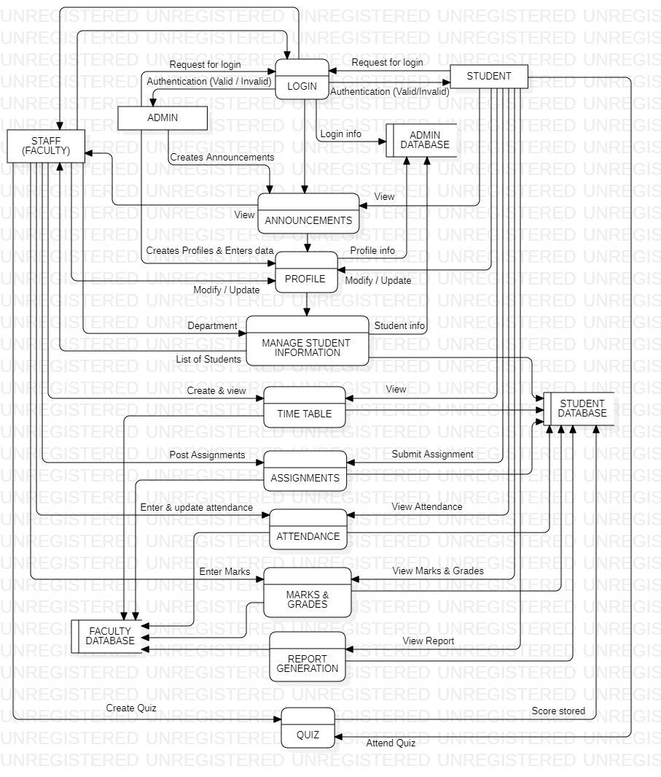
DFD DIAGRAM
LEVEL - 2

Slide 9
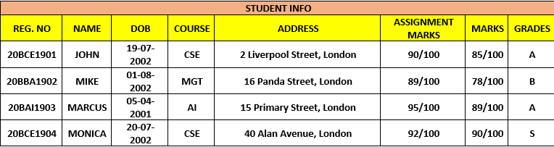
DATA DICTIONARY
STUDENT INFO

Slide 10
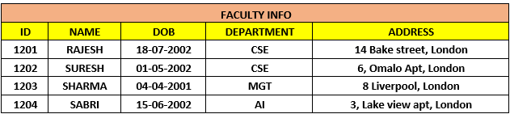
DATA DICTIONARY
FACULTY INFO

Slide 11
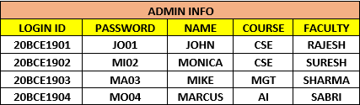
DATA DICTIONARY
ADMIN INFO

Slide 12
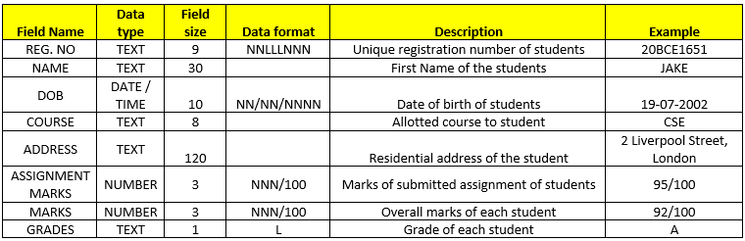
DICTIONARY
STUDENT INFO

Slide 13
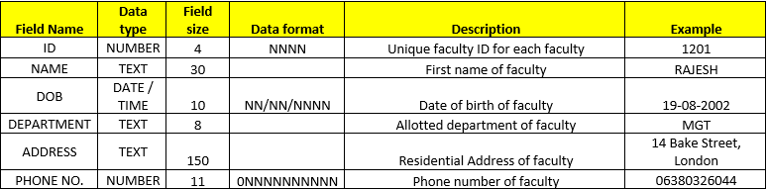
DICTIONARY
FACULTY INFO

Slide 14
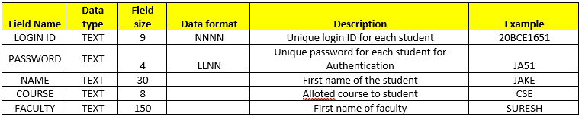
DICTIONARY
ADMIN INFO

Slide 15
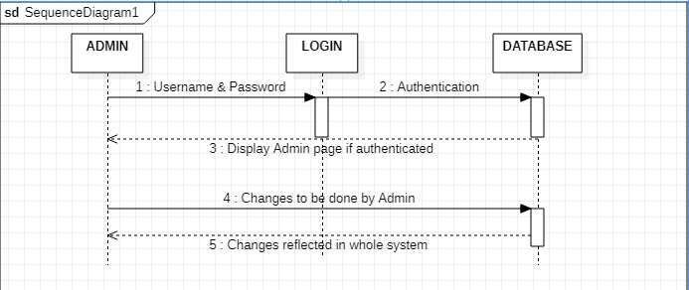
SEQUENCE DIAGRAMS
ADMIN LOGIN

Slide 16
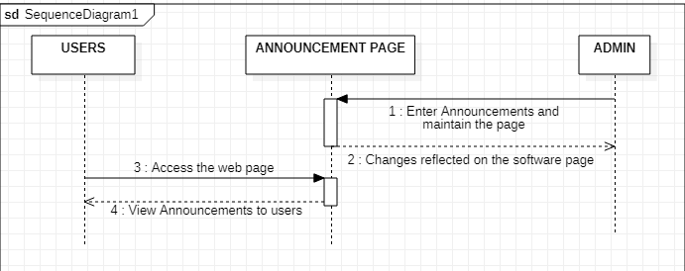
SEQUENCE DIAGRAMS
ANNOUNCEMENT

Slide 17
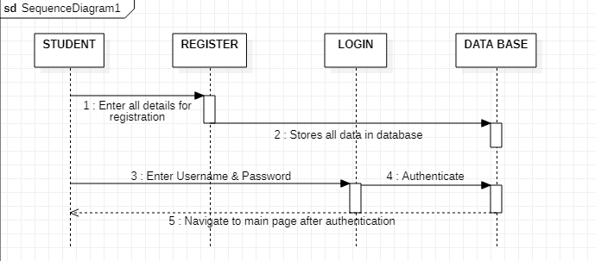
SEQUENCE DIAGRAMS
STUDENT REGISTER AND LOGIN

Slide 18
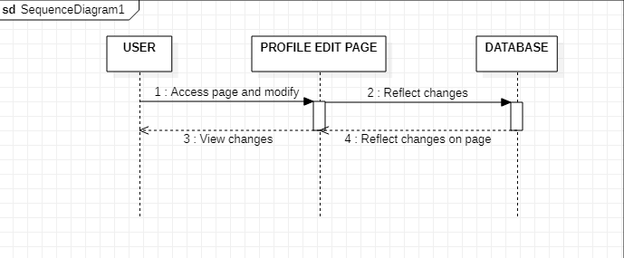
SEQUENCE DIAGRAMS
PROFILE UPDATION

Slide 19
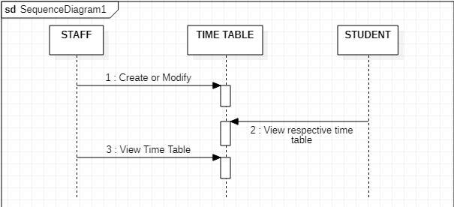
SEQUENCE DIAGRAMS
TIME TABLE

Slide 20
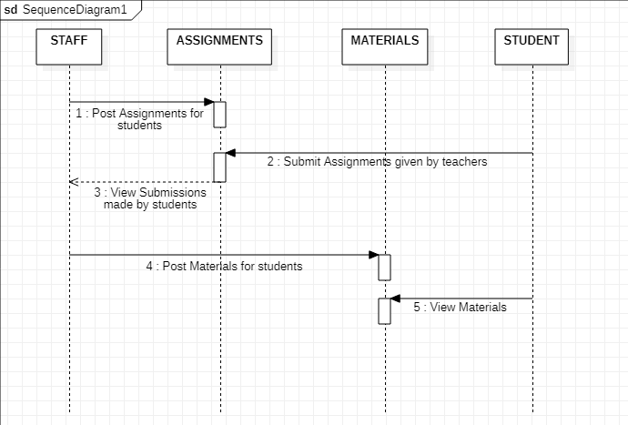
SEQUENCE DIAGRAMS
ASSIGNMENTS AND MATERIALS

Slide 21
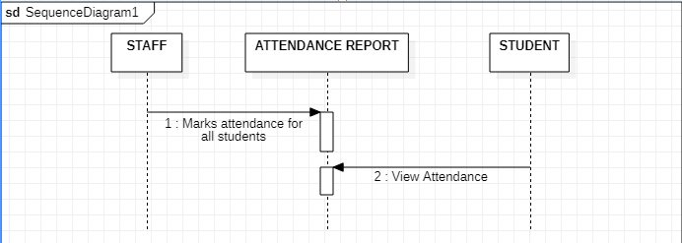
SEQUENCE DIAGRAMS
ATTENDANCE

Slide 22
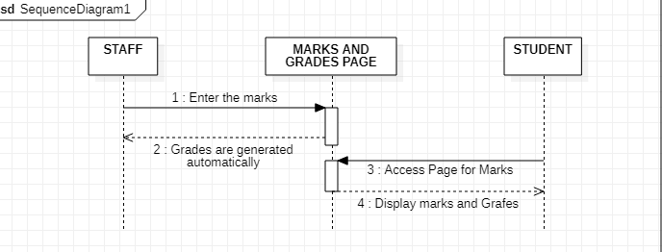
SEQUENCE DIAGRAMS
MARKS AND GRADES

Slide 23
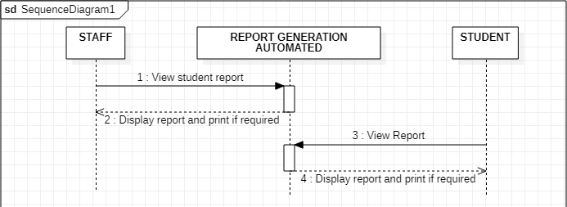
SEQUENCE DIAGRAMS
REPORT CARD GENERATION

Slide 24
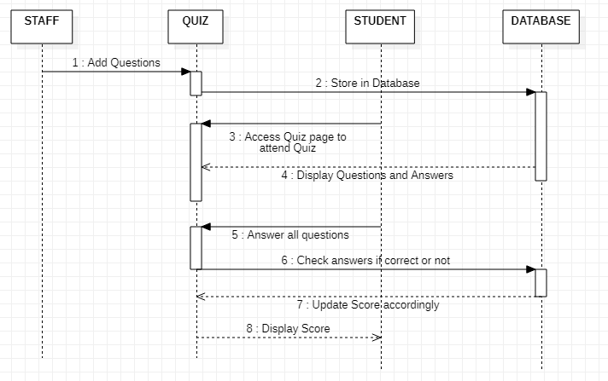
SEQUENCE DIAGRAMS
QUIZ

Slide 25
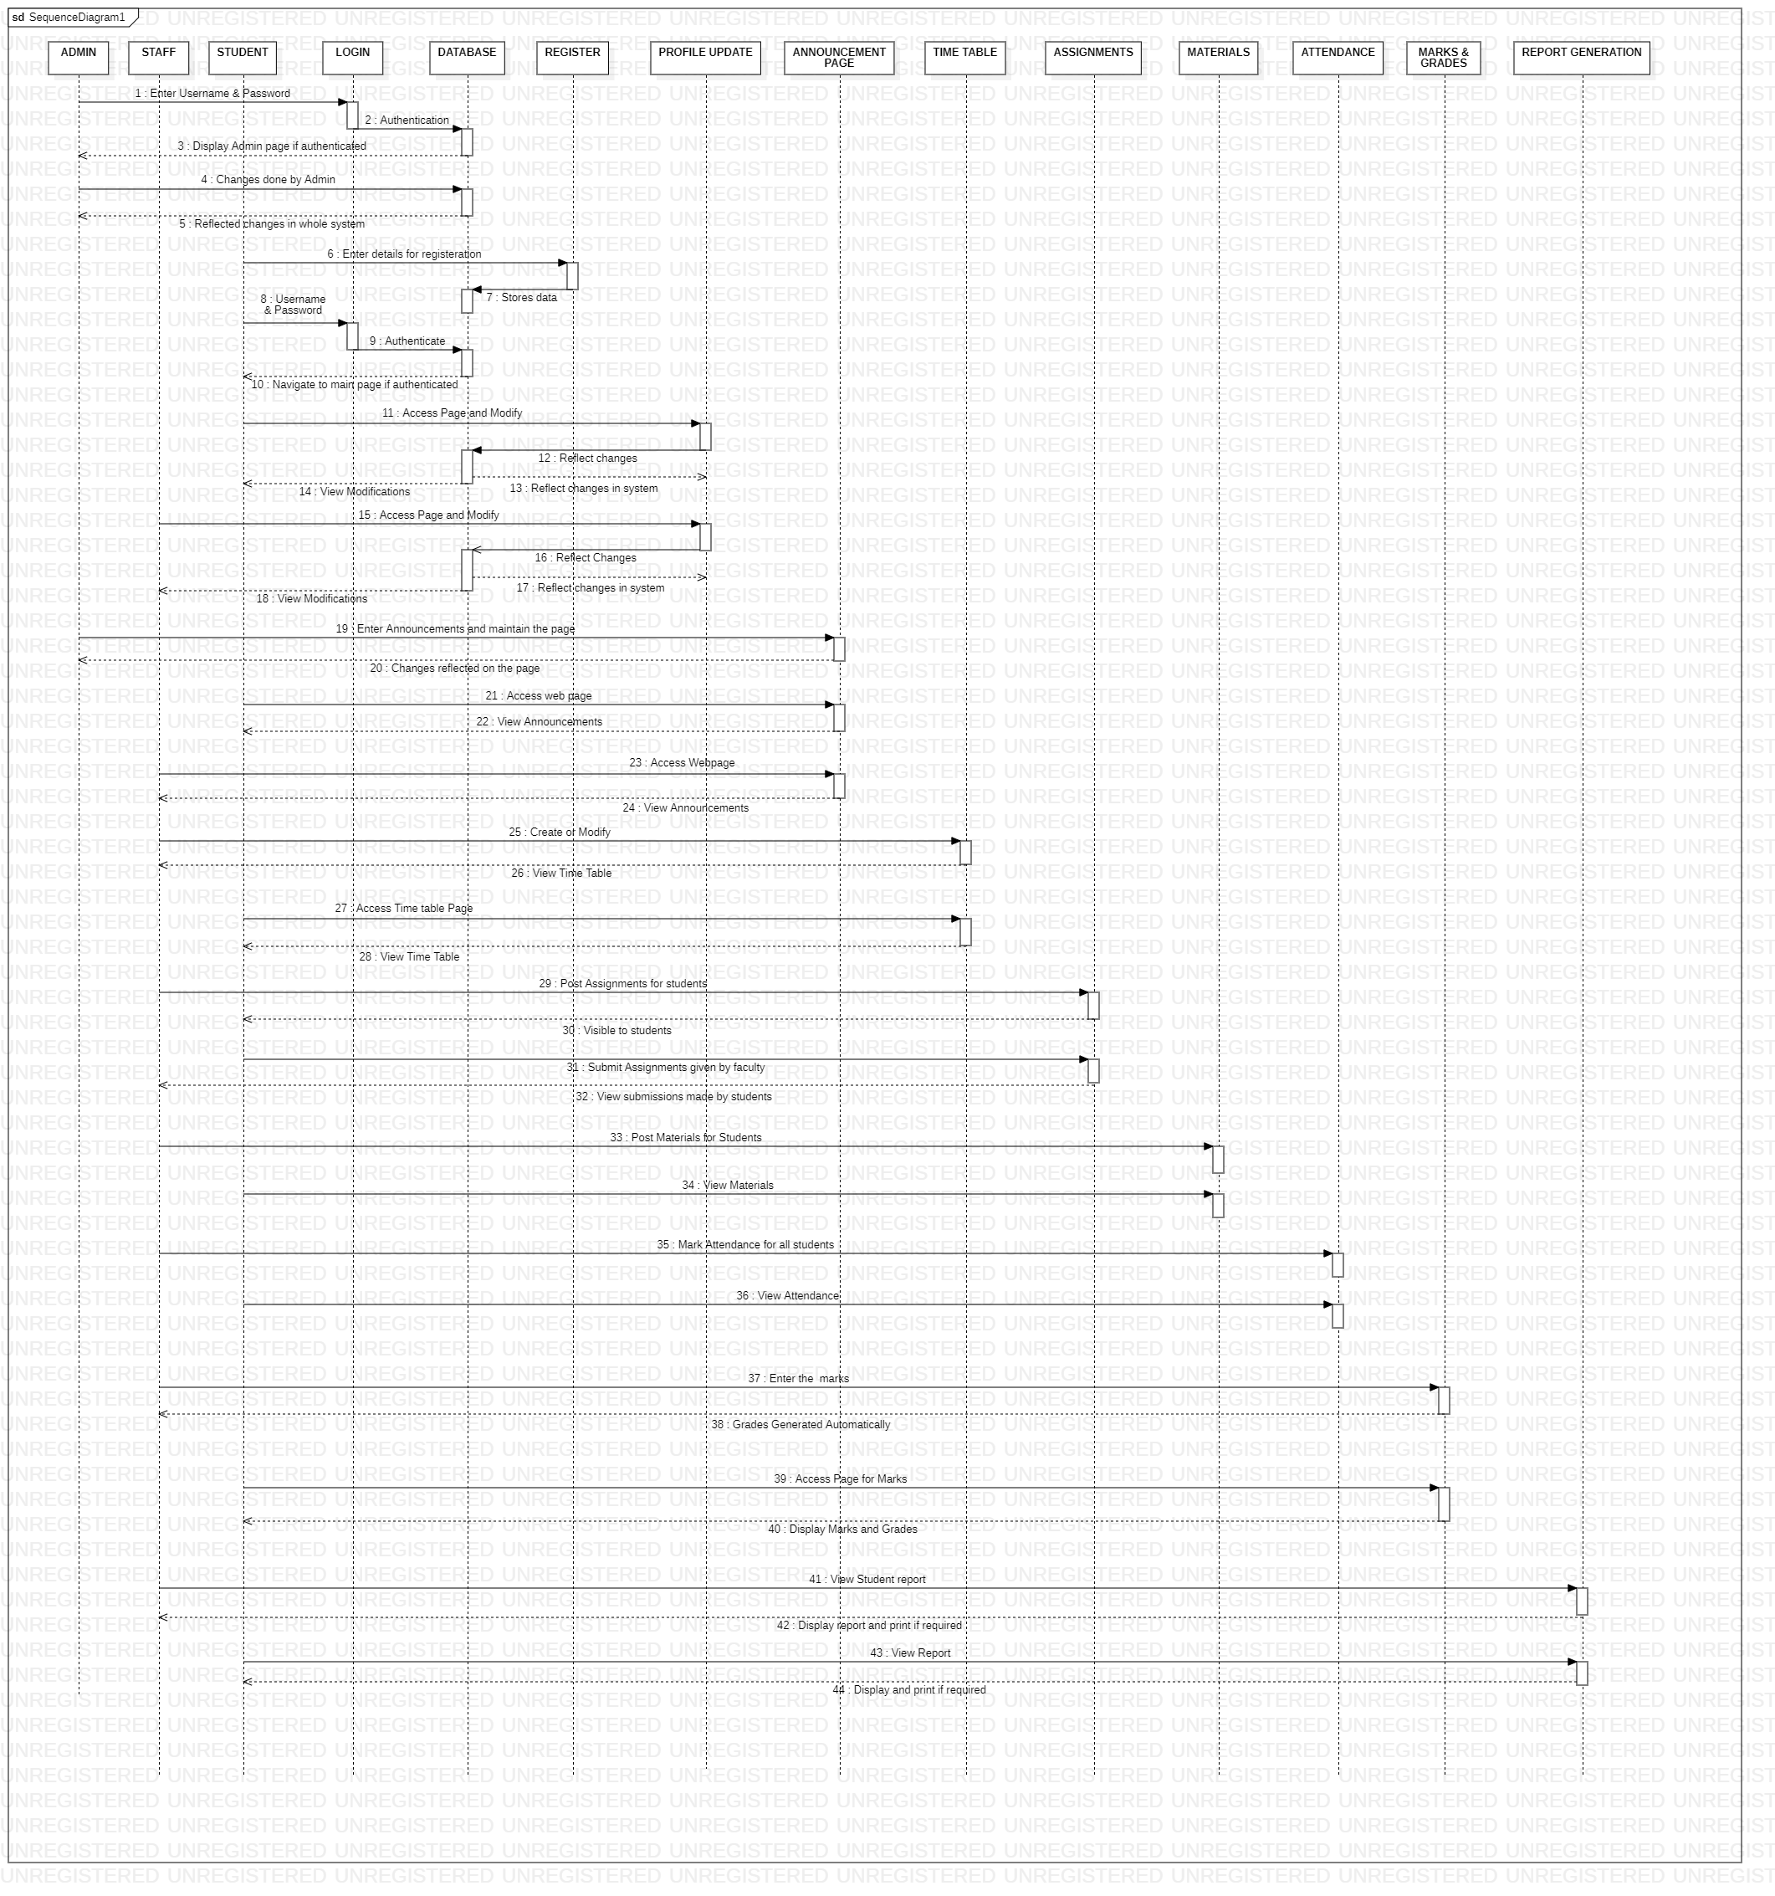
SEQUENCE DIAGRAMS
OVERALL SEQUENCE DIAGRAM

Slide 26
WORK PLAN

Slide 27
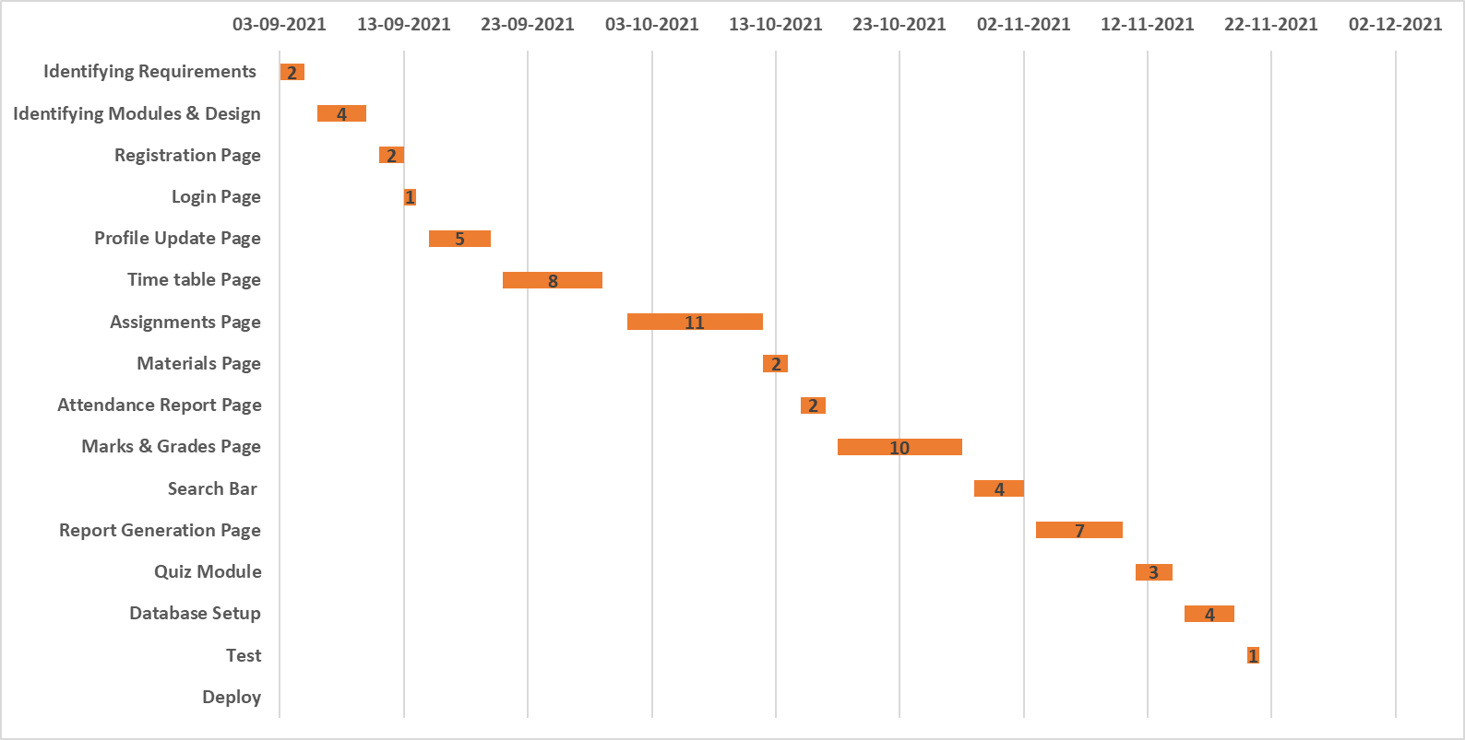
GANTT CHART

Slide 28
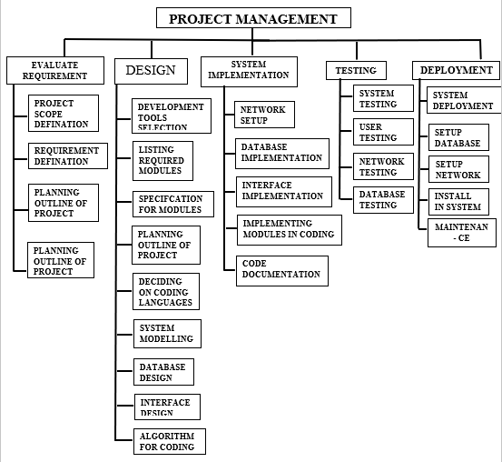
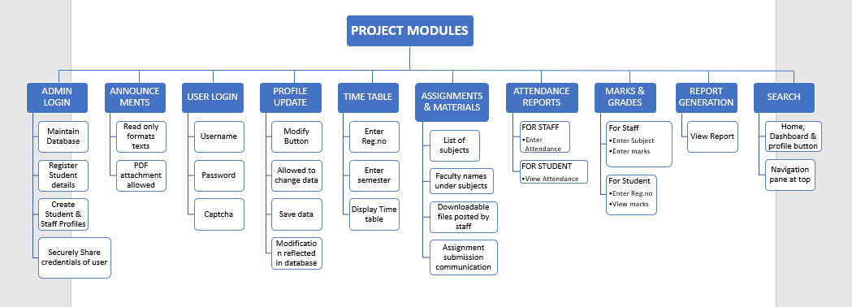
WBS

Slide 29
TEST CASES

Slide 30

Module Description
1. ADMIN LOGIN
The admin of the software can manage the operations and can maintain the software and also check if there is any failure in the system.
SPECIFICATION: Place holders for username & password. A submit button with university logo and information.
2. ANNOUNCEMENTS
Here the students and the staff members can view all the important information regarding any current events or academic announcements in this section. SPECIFICATION: Announcement as title, all entered announcements to be displayed in bulletin points.
3. STAFF LOGIN
The registered staff members can enter their credentials and also can manipulate their profiles.
SPECIFICATION: Place holders for username & password. A submit button.

Slide 31
4. STUDENT REGISTERATION AND LOGIN:
Students need to register themselves into the system. Registered students can access the system by logging into it
SPECIFICATION (Register): Place holders for Name, Age, Gender, Course and all other information required. A placeholder for storing passport size photo of student. A button to save changes/Submit. SPECIFICATION (Login): Place holders for username & password. A submit button. .
5. PROFILE UPDATION
The system allows the Staff member as well as Students to update their profile.
SPECIFICATION: Displays profile. Modify Button. If clicked it allows to modify the data. Save changes button.
6. TIME TABLE
The staff can create and modify the time table of particular students under them. Both the staff and students can view the time table.
SPECIFICATION: Displays time table created by staff in a tabular form.

Slide 32
7. ASSIGNMENTS
Staff members can assign digital assignments and projects to the students.
SPECIFICATION (staff): Option to create Topics and upload assignments under the respective topics. View button to display the summary of students who have submitted and the defaulters. SPECIFICATION (student): Download button to download the assignment uploaded by the faculty. Upload button to upload the assignment for student. Submit button to Submit.
8. MATERIALS
Staff members can provide materials, books, notes and other reference materials required for the subject.
SPECIFICATION (staff): Option to create Topics and upload materials under the respective topics. SPECIFICATION (student): Download button to download the materials uploaded by the faculty.
9. ATTENDANCE REPORT
It will maintain daily attendance reports and generate automated overall report students wise.
SPECIFICATION (staff): List of students and a drop down by side of it. It will contain options of Present and Absent.
SPECIFICATION (student): View attendance in tabular form of all subjects

Slide 33
10. MARKS & GRADES
Here the system will allow the staff members to enter marks of the students subject wise or also individual student wise. The Grade system will operate automatically based on entered marks and class average.
SPECIFICATION (staff): Class/Subject wise categories. Entry of marks of students. Displaying student name and other details. Placeholder to enter marks.
SPECIFICATION (student): View marks and Grades respectively.
11. SEARCH
The Search operation will help staff members to navigate to a particular student and view their information, attendance reports, marks, grades etc.
SPECIFICATION (staff): Place holder to search Student name, Courses and easy navigation to different modules directly.
12. REPORT GENERATION
Here, the system allows Staff member as well as students to view and print the respective reports.
SPECIFICATION: Displays automated generated report by system based on marks, grades, evaluation of assignments done by staff. Print button to print the report.

Slide 34

Applications utilized to design the project:
Front End:
HTML,CSS
Back End:
PHP
Database:
MySql
Others:
Xampp :- To connect back end PHP to database.
VS Code :- For PHP, HTML and CSS coding.
Phpmyadmin :- To maintain Database.

Slide 35

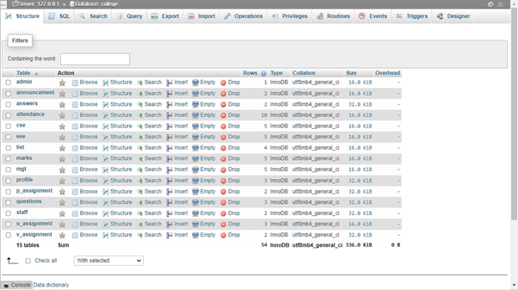
DatabASE of the project

Slide 36
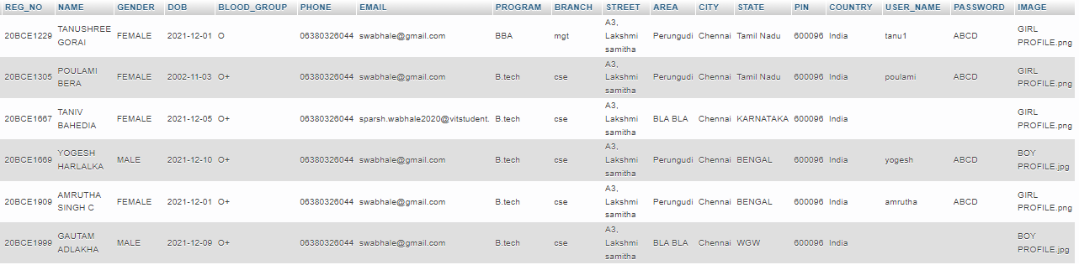
PROFILE TABLE

Slide 37
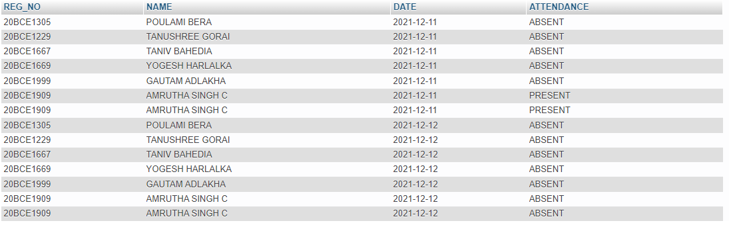
ATTENDANCE TABLE

Slide 38
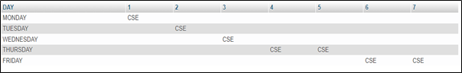
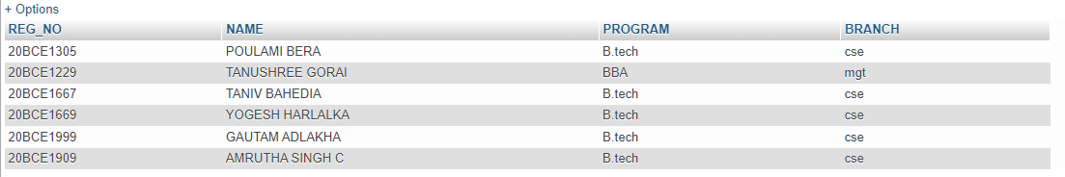
TIME TABLE example for CS Students
LIST OF STUDENTS

Slide 39
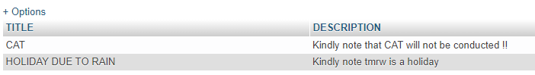
ADMIN LOGIN TABLE
ANNOUNCEMENT
MARKS

Slide 40
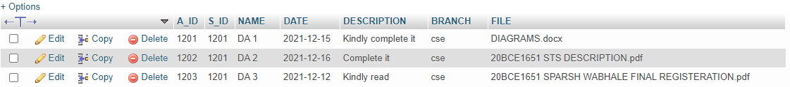
POST ASSGNMENT
SUBMISSIONS
FACULTY LOGIN

Slide 41
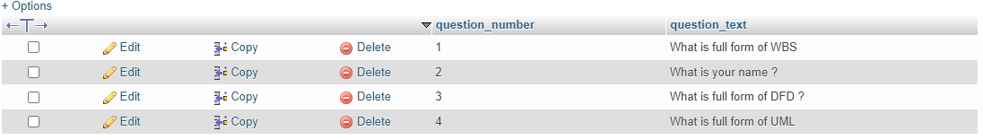
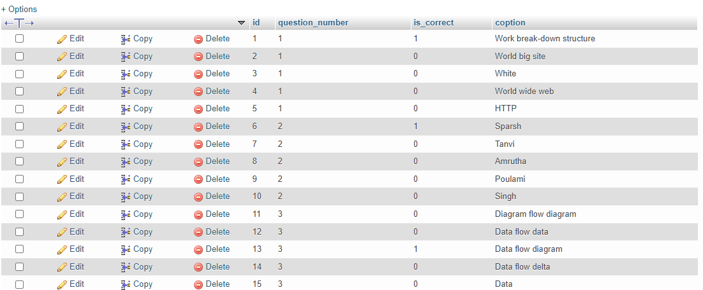
QUESTIONS - QUIZ
OPTIONS:

Slide 42
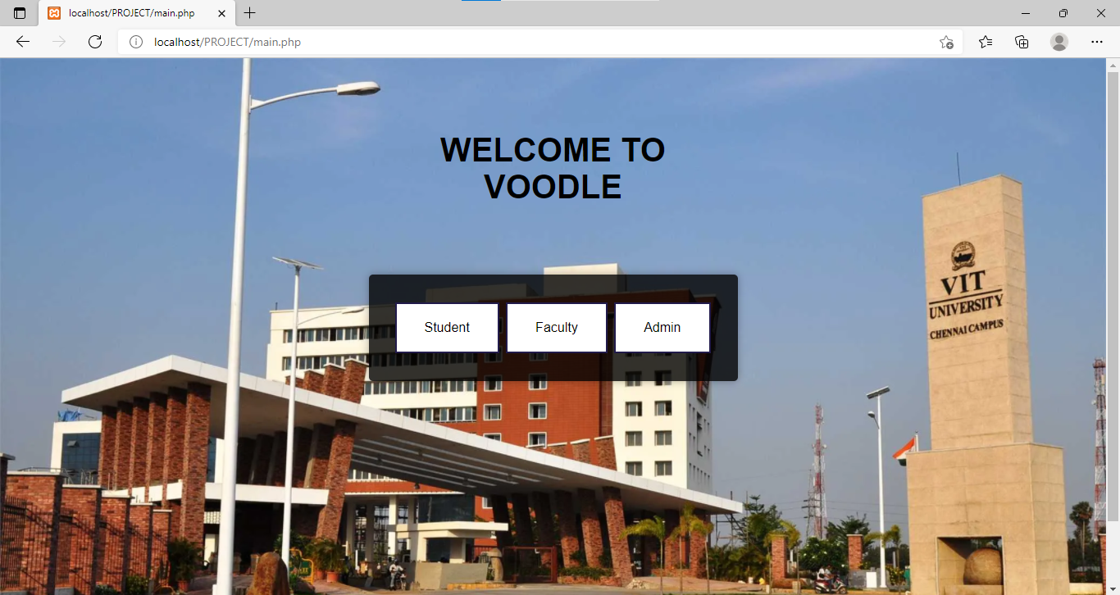
Implemented project overview
MAIN PAGE

Slide 43
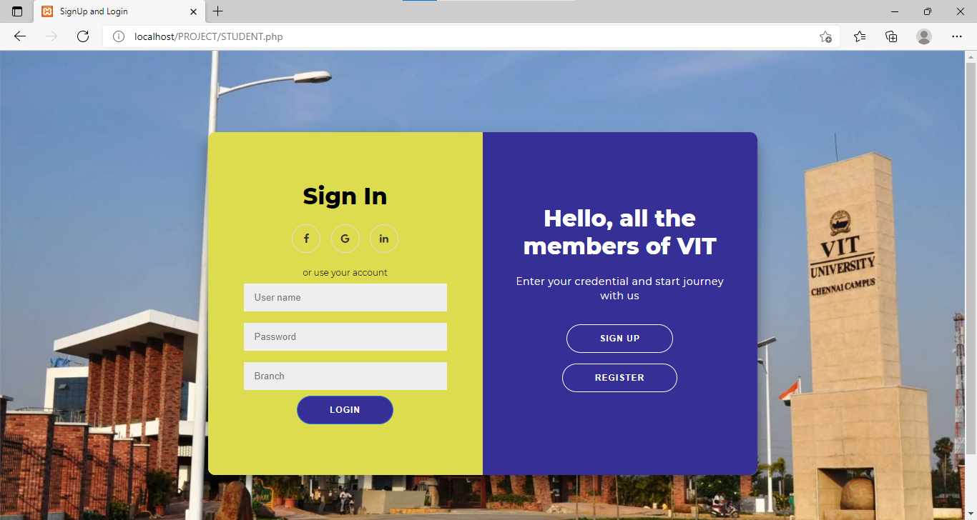
Implemented project overview
SIGNUP / LOGIN PAGE (STUDENT INTERFACE)

Slide 44
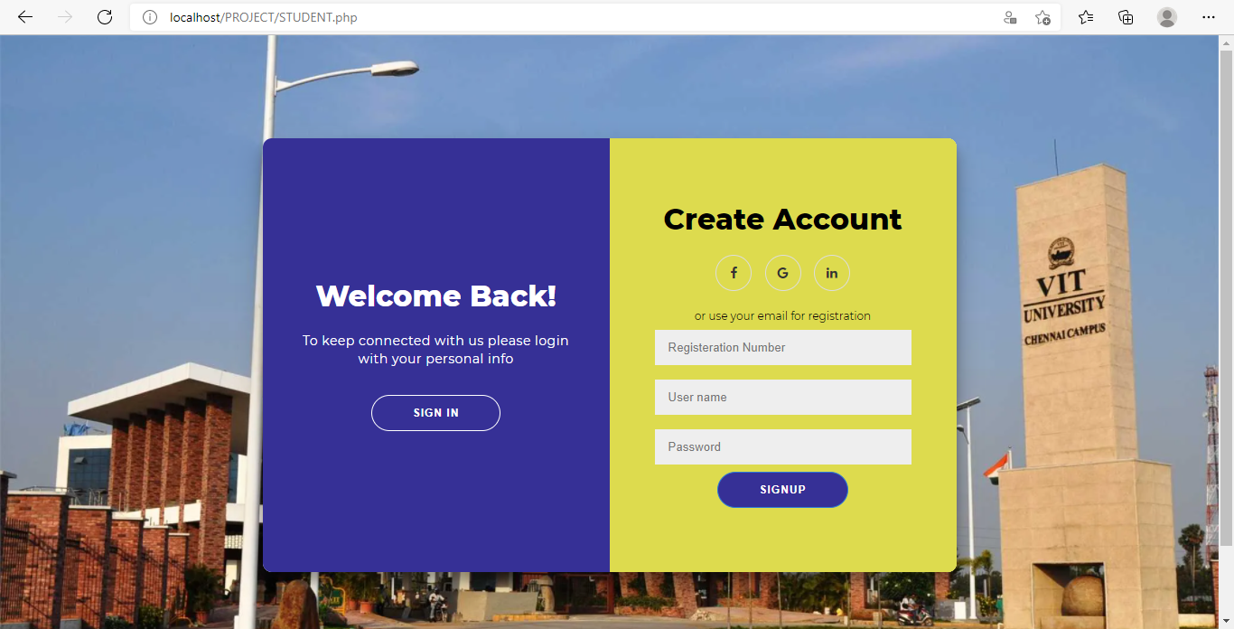
Implemented project overview
CREATE ACCOUNT (STUDENT)

Slide 45
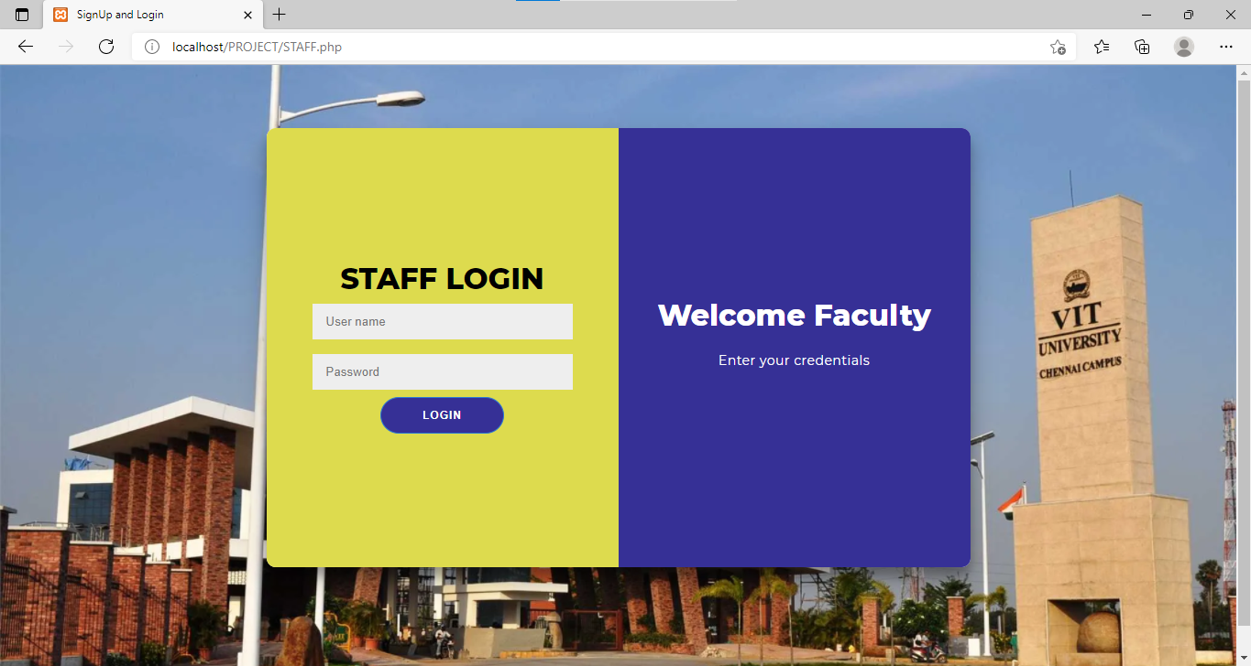
Implemented project overview
SIGNUP / LOGIN PAGE (FACULTY INTERFACE)

Slide 46
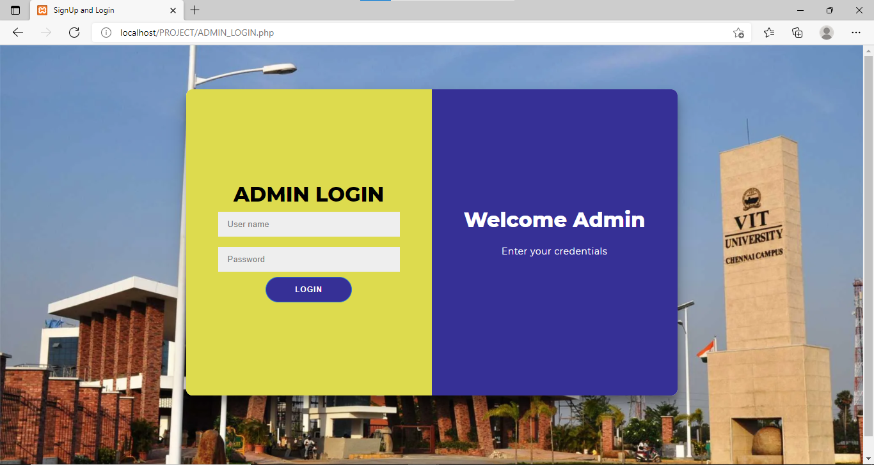
Implemented project overview
SIGNUP / LOGIN PAGE (ADMIN INTERFACE)

Slide 47
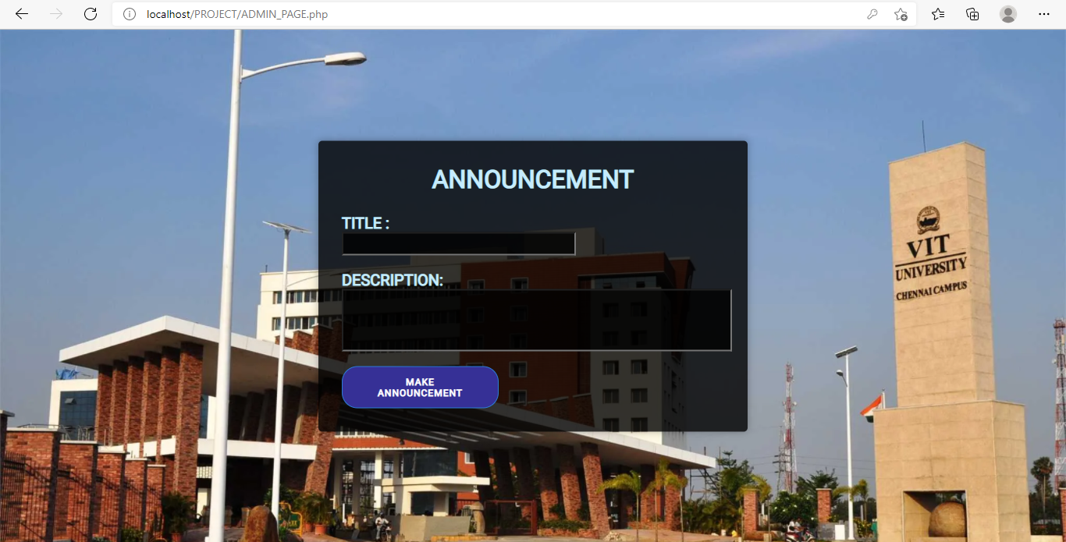
Implemented project overview
ADMIN PAGE - ANNOUNCEMENT

Slide 48
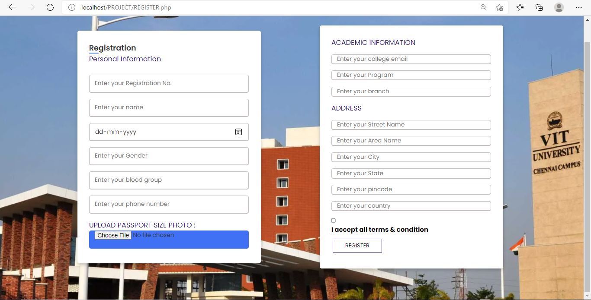
Implemented project overview
REGISTERATION PAGE (STUDENT INTERFACE)

Slide 49
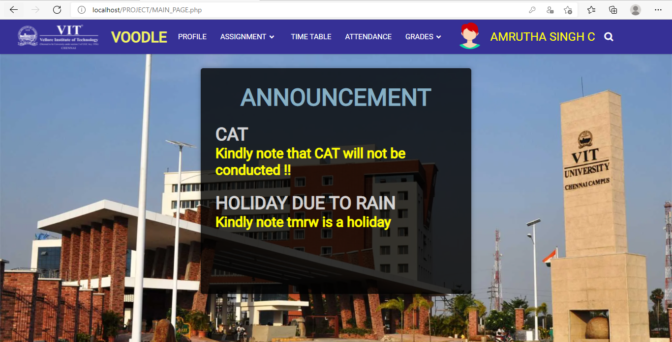
STUDENT MAIN PAGE

Slide 50
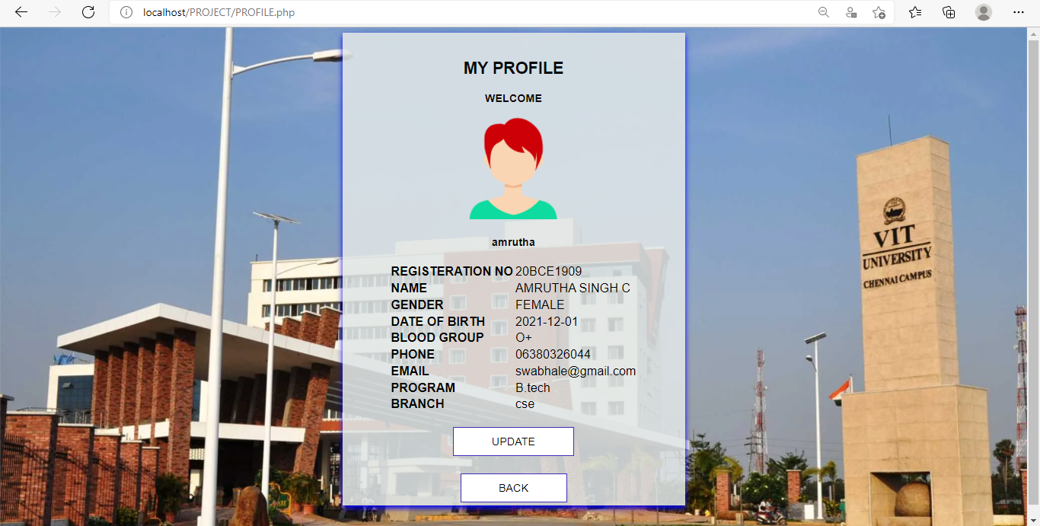
PROFILE PAGE (STUDENT)

Slide 51
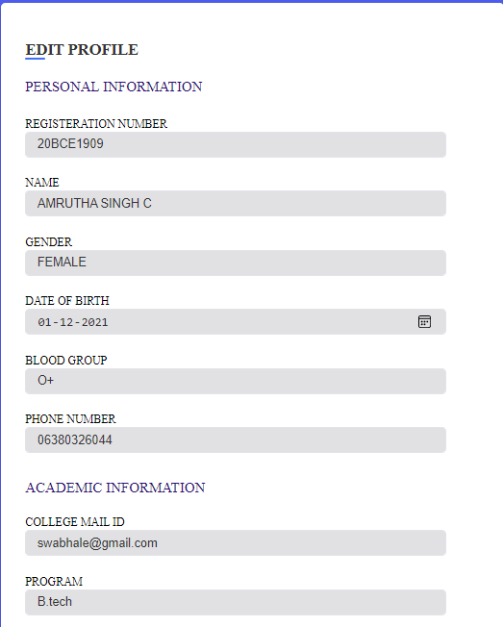
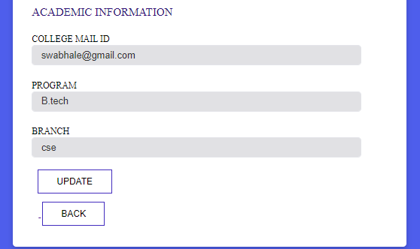
EDIT PROFILE PAGE

Slide 52
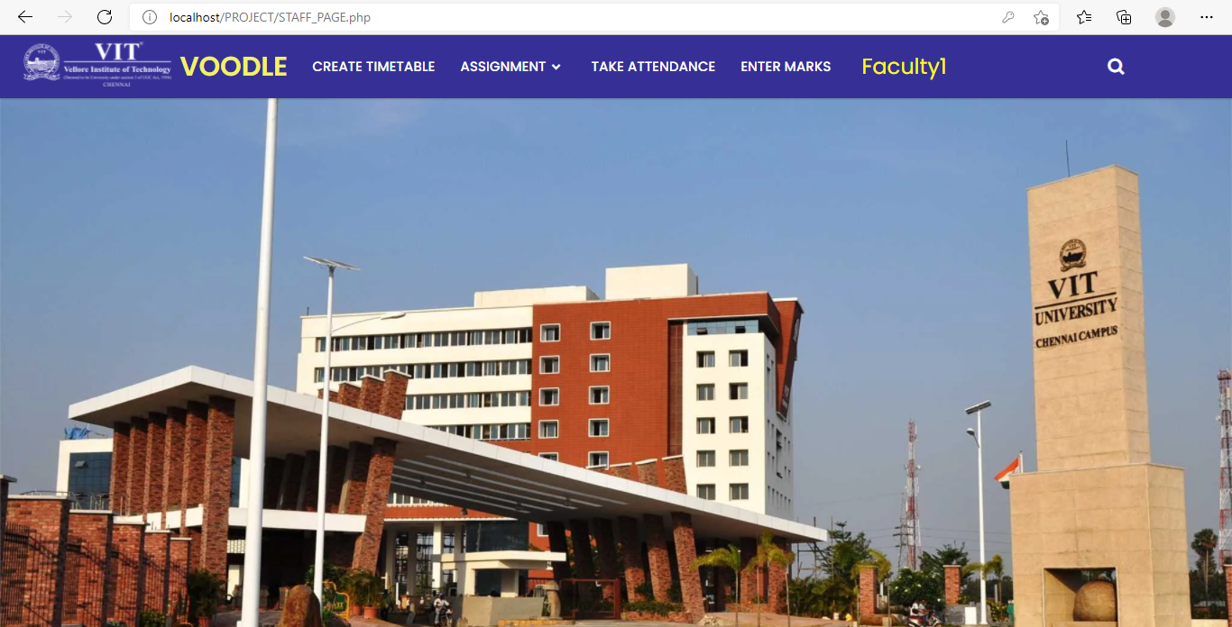
STAFF MAIN PAGE

Slide 53
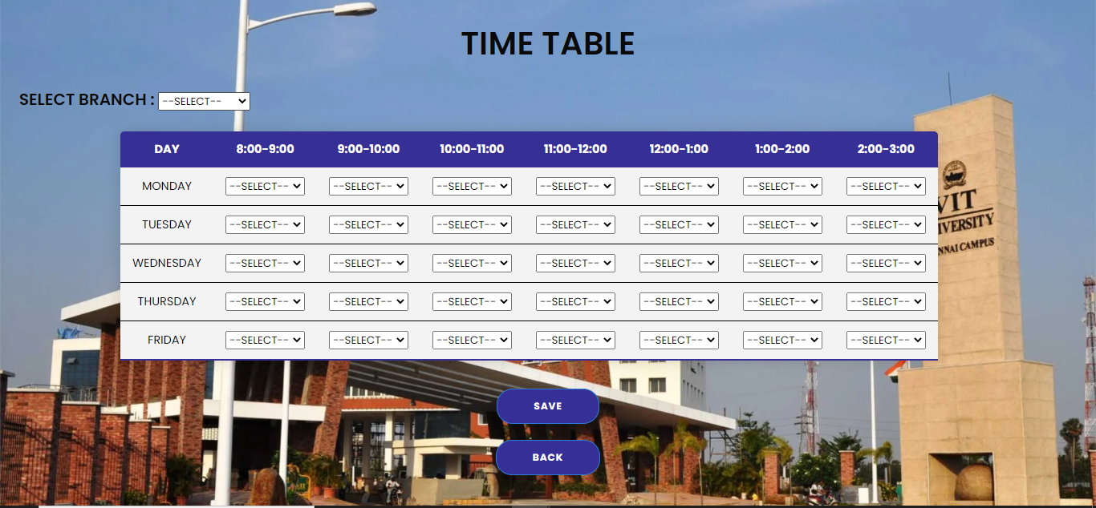
CREATE TIME TABLE

Slide 54
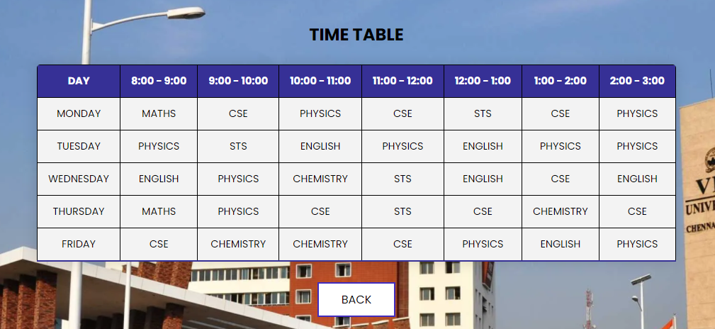
VIEW TIME TABLE (STUDENT INTERFACE)

Slide 55
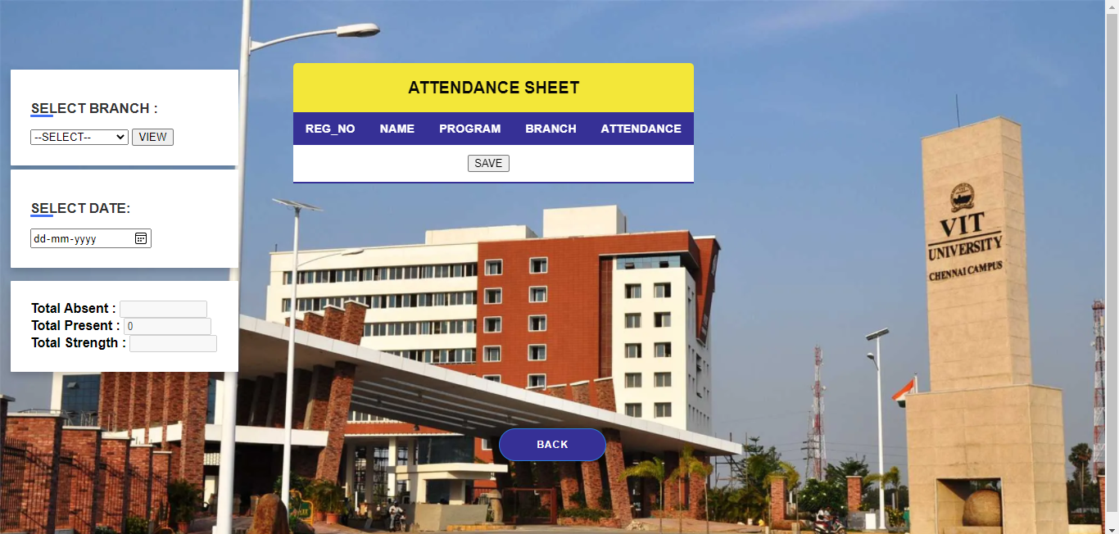
ATTENDANCE
FACULTY INTERFACE

Slide 56
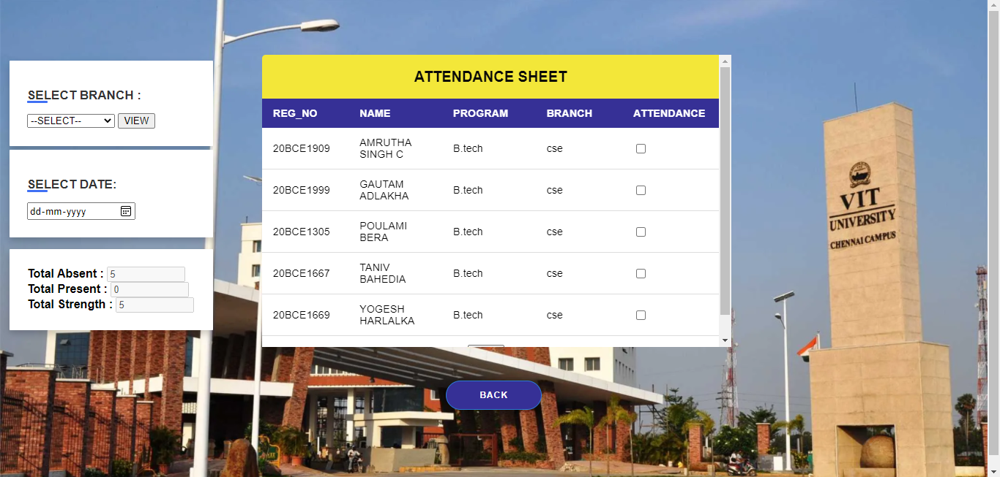
ATTENDANCE
FACULTY INTERFACE

Slide 57

ATTENDANCE
STUDENT INTERFACE

Slide 58

ASSIGNMENTS
FACULTY INTERFACE
CREATE ASSIGNMENT

Slide 59

ASSIGNMENTS
STUDENT INTERFACE

Slide 60


VIEW ASSIGNMENT (STUDENT INTERFACE)
If View Assignment clicked
If Submit Assignment clicked

Slide 61

ASSIGNMENTS
FACULTY INTERFACE – VIEW SUBMISSIONS

Slide 62

ASSIGNMENTS
FACULTY INTERFACE – VIEW SUBMISSIONS

Slide 63

ENTER MARKS (FACULTY INTERFACE)

Slide 64

ENTER MARKS (FACULTY INTERFACE)
If enter marks is clicked

Slide 65

VIEW MARKS (STUDENT INTERFACE)

Slide 66

PRINT REPORT (OVERALL) STUDENT INTERFACE
If OVERALL button clicked the PDF gets downloaded

Slide 67

CREATE QUIZ – FACULTY INTERFACE

Slide 68



ANSWER QUIZ – STUDENT INTERFACE

Slide 69

User documentation
The software is very simple to be downloaded and installed in the system. The system administrator should first set up a centralized database for the university. Then the software can be installed in all the systems of the university and can be connected to the central database using LAN.
The system administrator should create database in the central server and will now be responsible for the maintenance of the server, database and the software.
The university can contact us in case of any technical problems in the software. The administrator should make sure the secure the network and servers to avoid any unauthorized login in the system.

Slide 70


Conclusion
It is a comprehensive student information management system developed from the ground up to fulfil the needs of independent Colleges as they guide their students to success.
The system integrated information automation system connects daily operations in the College environment ranging from Admissions and Registration to Finance, Faculty, timetable and attendance. This reduces data error and ensures that information is always up-to-date throughout the College.
If implemented it can efficiently reduce the work load and increase the performance of maintenance, manageability and sorting of records, etc.

